Slide 1

Mathematical modelling for vaccine-preventable diseases
Epidemiology lecture 7
Modelling vaccine effects
Andrew J K Conlan & Katy Gaythorpe
ajkc2@cam.ac.uk & k.gaythorpe@imperial.ac.uk
Notes:
Introduce who we are

Slide 2
Aims
Further explore the impact of vaccination on transmission
How does the interval between outbreaks change after vaccination?
What are the main modes of action of a vaccine
How do we extend SIR framework to model different vaccine effects?
How do estimate the mode of action of a vaccine?
Case Study: Norovirus

Slide 3
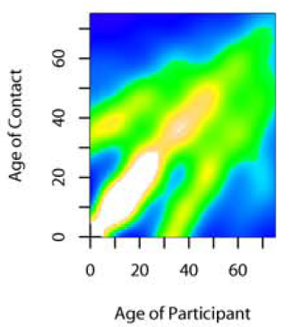
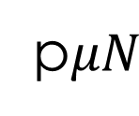
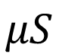
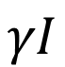
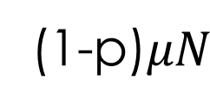
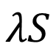
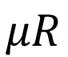
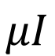
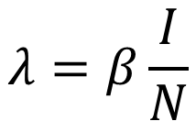
Modelling Vaccination
p$μN$
S
$$λS$$
I
$$γI$$
R
(1-p)$μN$
$$λ=β\frac{I}{N}$$
$$μS$$
$$μI$$
$$μR$$
Critical Vaccination Threshold
Mean Age At Infection
Core Groups

Slide 4
Measles in London 1944-1964
Measles epidemics demonstrate endemic-epidemic patterns of incidence
E.g. In London there was a stable two year cycle in incidence between 1950 and 1964
The Registrar Generals Weekly Returns for England and Wales (OPCS)

Slide 5
Measles Life History
Morbillivirus – characteristic red rash (high reporting rates)
Symptoms include: fever, cough, coryza and conjunctivitis
Long term immunomodulation which likely increases contribution to childhood infectious disease mortality
Spread by aerosol transmission, no animal reservoirs
Infection results in life long immunity to reinfection
Exceptionally high reproduction ratio R₀ of ~ 17
Acute infectious period (around the same time as symptoms peak) that is short relative to the incubation (or latent) period where individuals are infected but not yet infectious

Slide 6
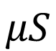
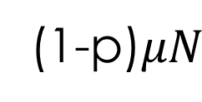
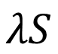
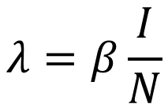
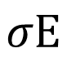
Modelling Vaccination
p$μN$
(1-p)$μN$
S
$$λS$$
E
$$σE$$
I
$$γI$$
R
$$μS$$
$$μI$$
$$μR$$
$$λ=β\frac{I}{N}$$

Slide 7
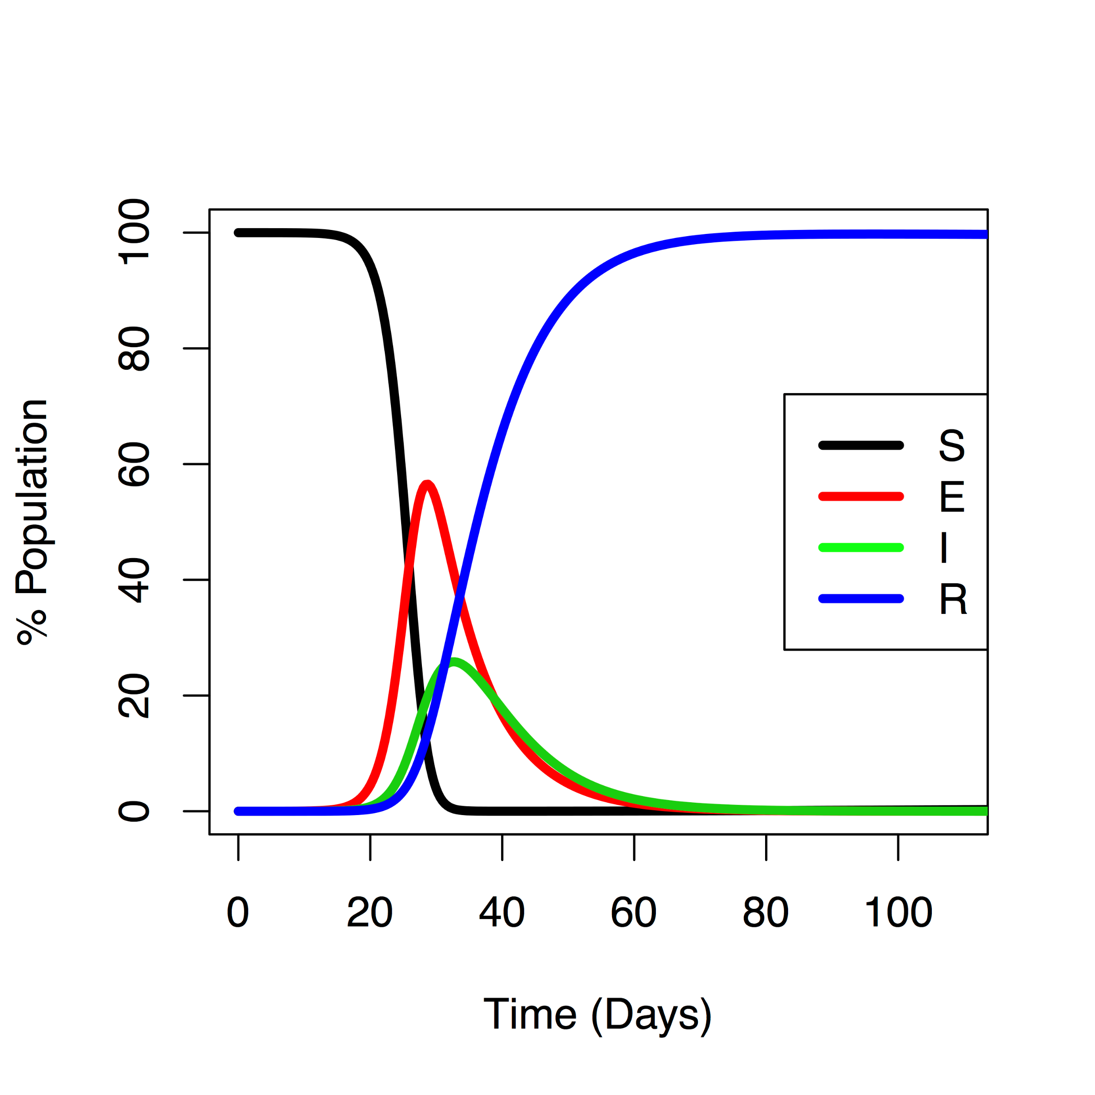
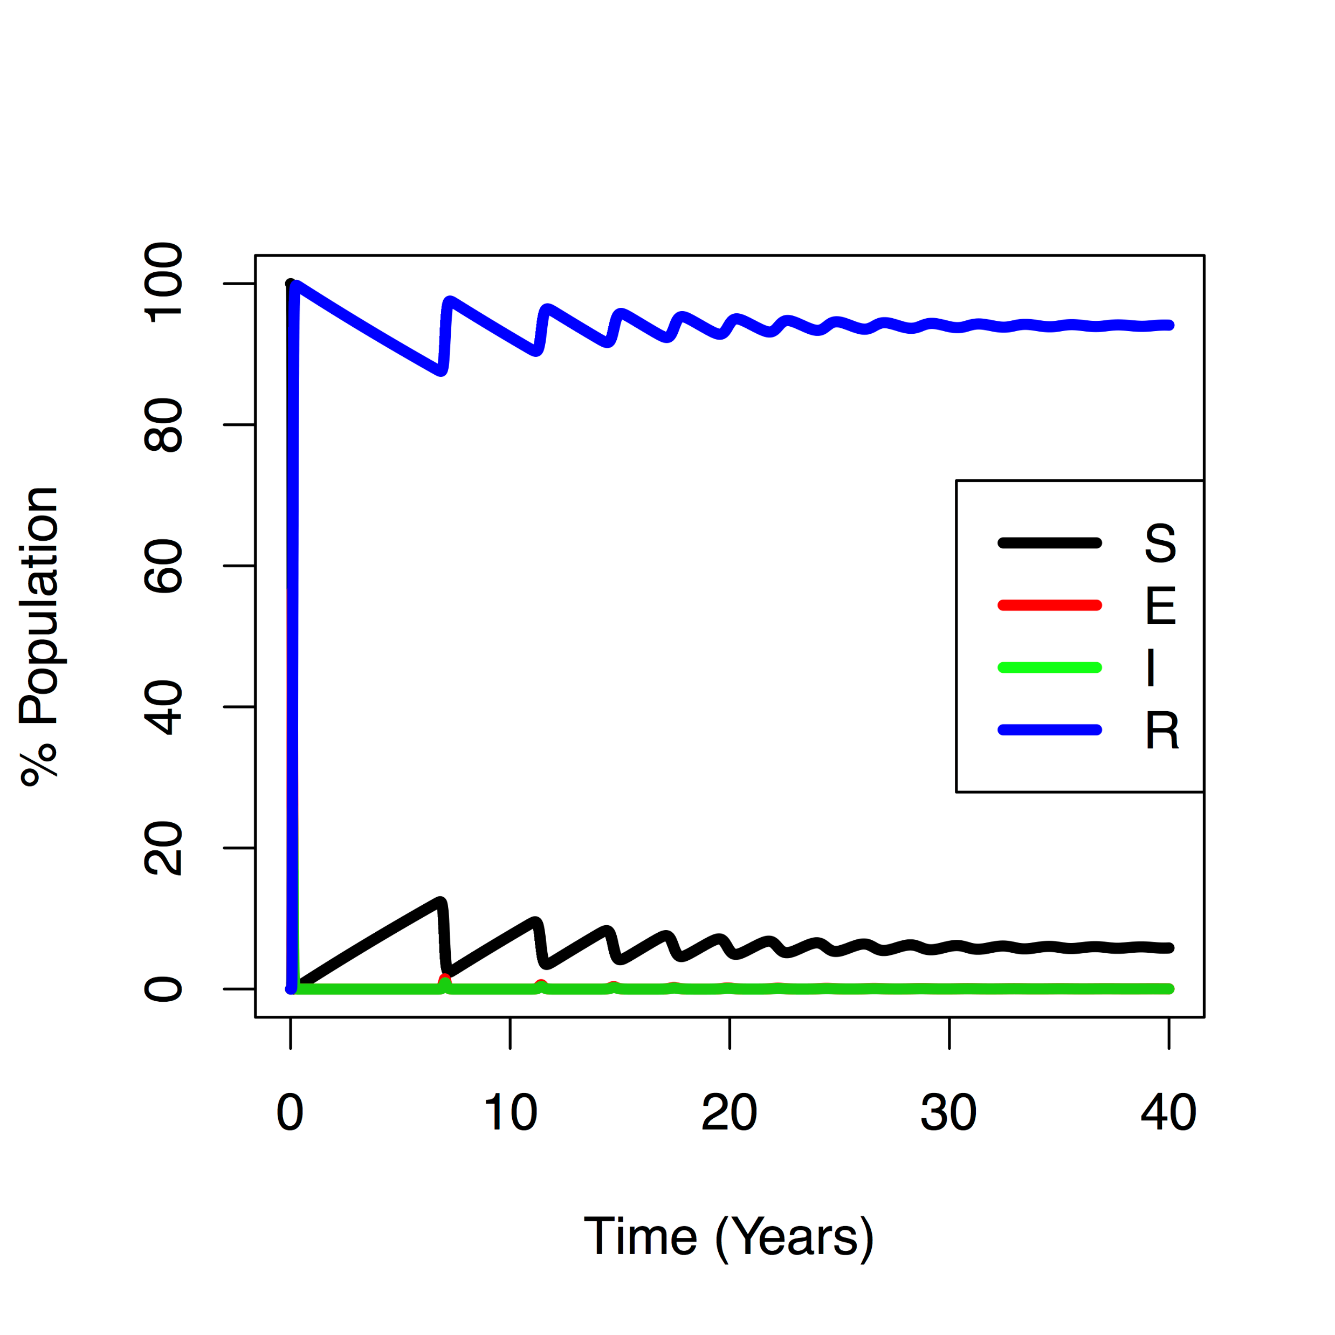
SEIR model with demography
l
SEIR model analogous to damped Pendulum (simple harmonic oscillator) with natural period of oscillation
Can force an oscillator to vibrate at arbitrary frequencies by varying parameters over time

Slide 8
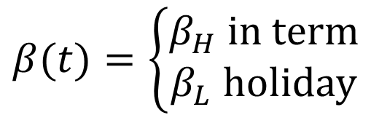
Seasonality in transmission
For infectious disease models many (potential) model parameters have season patterns of variation
Birth rates, mortality rates, temperature, precipitation, environmental survival
Analysis of incidence data from England and Wales reveals strong evidence for seasonal variation in estimated transmission rates co-incident with the (average) timing of the school terms (red)
Becker & Grenfell https://doi.org/10.1371/journal.pone.0185528
Fine & Clarkson (1982) https://doi.org/10.1093/ije/11.1.5
Term-time forcing
$$β(t)=\left\{\begin{aligned}β_{H} \text{in} \text{term} \\ β_{L} \text{holiday}\end{aligned}\right.$$

Slide 9
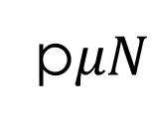
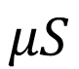
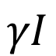
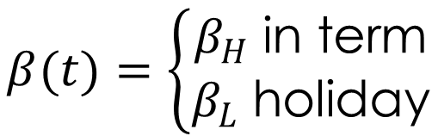
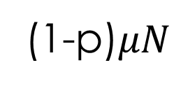
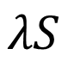
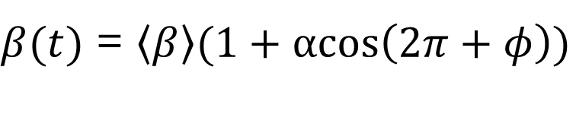
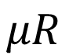
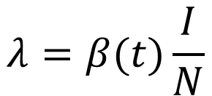
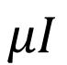
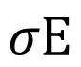
Modelling Seasonality
p$μN$
(1-p)$μN$
S
$$λS$$
E
$$σE$$
I
$$γI$$
R
$$μS$$
$$μI$$
$$μR$$
Sinusoidal forcing
$$λ=β(t)\frac{I}{N}$$
$β(t)$ = $\left\langle β\right\rangle (1+αcos\left(2π+φ\right))$
Term-time forcing
$$β(t)=\left\{\begin{aligned}β_{H} \text{in} \text{term} \\ β_{L} \text{holiday}\end{aligned}\right.$$

Slide 10
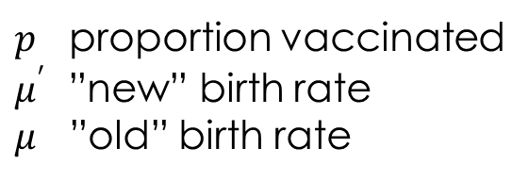
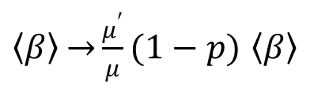
Seasonality in Transmission
$p$ proportion vaccinated
$μ^{′}$ ”new” birth rate
$μ$ ”old” birth rate
Effective Transmission Rate
$\left\langle β\right\rangle \underset{→}{}\frac{μ^{′}}{μ}(1−p)$ $\left\langle β\right\rangle$

Slide 11
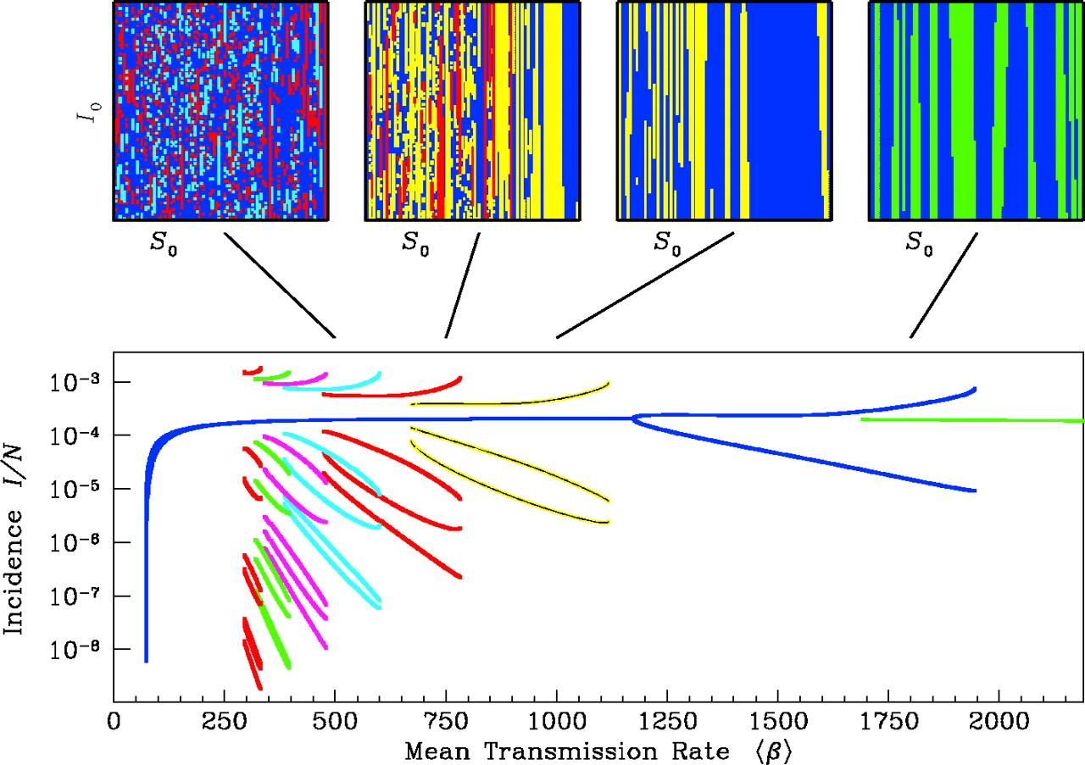
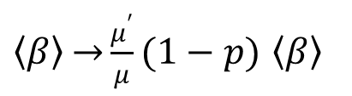
Bifurcation diagram for term-time forcing model
For fully immunizing vaccines (sterilizing immunity) the dynamical effects of vaccination are equivalent to an effective reduction in transmission rate
$\left\langle β\right\rangle \underset{→}{}\frac{μ^{′}}{μ}(1−p)$ $\left\langle β\right\rangle$
Earn et al.
DOI: 10.1126/science.287.5453.667

Slide 12
Measles in London 1944-1964
Annual epidemics between 1944 and 1950 were the result of the post-WWII baby boom
Higher birth rates (anti-vaccination!) meant more frequent outbreaks
The Registrar Generals Weekly Returns for England and Wales (OPCS)

Slide 13
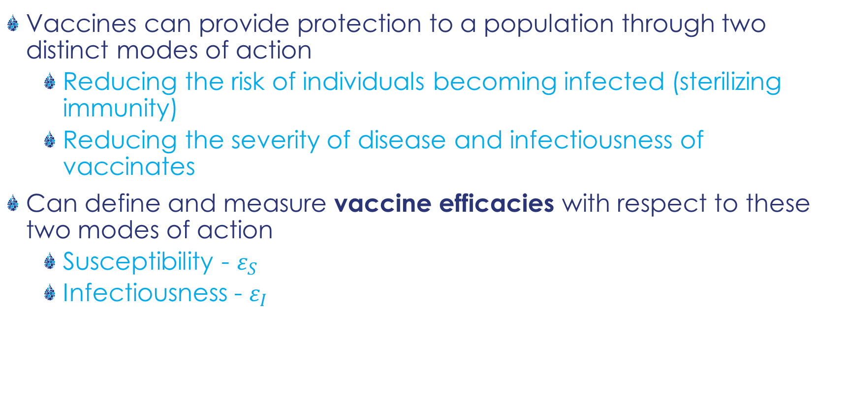
Modes of action of vaccines
Vaccines can provide protection to a population through two distinct modes of action
Reducing the risk of individuals becoming infected (sterilizing immunity)
Reducing the severity of disease and infectiousness of vaccinates
Can define and measure vaccine efficacies with respect to these two modes of action
Susceptibility - $ε_{S}$
Infectiousness - $ε_{I}$
Susceptibility
Both contribute
to total efficacy
Infectivity

Slide 14
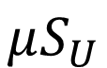
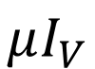
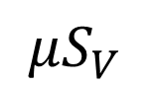
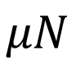
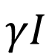
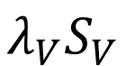
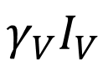
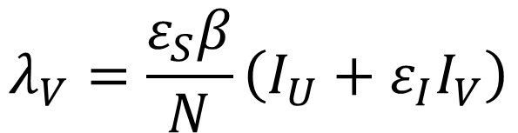
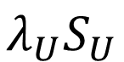
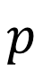
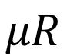
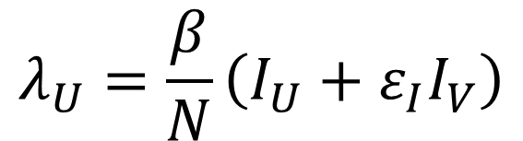
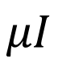
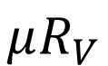
Modelling different modes of action
(1-p)
$$λ_{U}S_{U}$$
$$γI$$
S_{U}
I
R
$$μN$$
$$λ_{U}=\frac{β}{N}\left(I_{U}+ε_{I}I_{V}\right)$$
$$p$$
$$μS_{U}$$
$$μI$$
$$μR$$
$$λ_{V}=\frac{ε_{S}β}{N}\left(I_{U}+ε_{I}I_{V}\right)$$
S_{V}
I_{V}
R_{V}
$$λ_{V}S_{V}$$
$$γ_{V}I_{V}$$
$$μS_{V}$$
$$μI_{V}$$
$$μR_{V}$$
Susceptibility
Infectivity

Slide 15
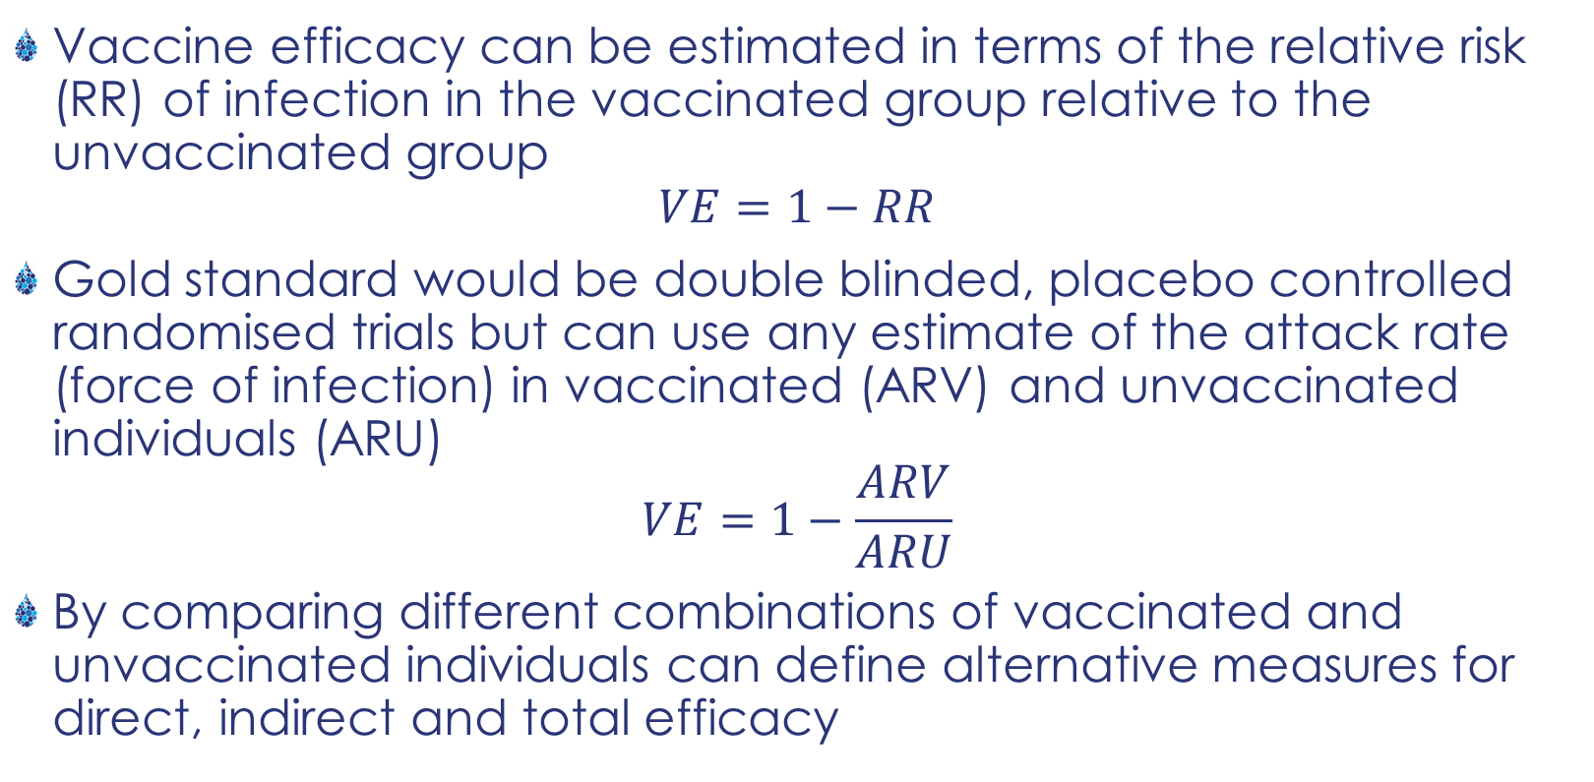
Field evaluation of Vaccine Efficacy
Vaccine efficacy can be estimated in terms of the relative risk (RR) of infection in the vaccinated group relative to the unvaccinated group
$$VE=1−RR$$
Gold standard would be double blinded, placebo controlled randomised trials but can use any estimate of the attack rate (force of infection) in vaccinated (ARV) and unvaccinated individuals (ARU)
$$VE=1−\frac{ARV}{ARU}$$
By comparing different combinations of vaccinated and unvaccinated individuals can define alternative measures for direct, indirect and total efficacy
Design and Interpretation of Vaccine Field Studies Halloran et al. Epidemiologic reviews (1999)

Slide 16
Direct Efficacy
Phase II
Trial
Indirect Efficacy
Phase III or IV
Trial
Total Efficacy

Slide 17
Natural Transmission Study Designs
Experimental designs can allow us to estimate indirect effects far more rapidly but use largely limited to animal populations…
Conlan AJK & De Jong, M https://doi.org/10.7554/eLife.27694.001

Slide 18

How can we predict the impact of new vaccines?
For human infectious diseases we typically we will not have complete information on the mode of action of a vaccine or indirect efficacy ahead of a full deployment

Slide 19
Case Study: Norovirus
Norovirus is the most common viral cause of gastroenteritis in humans, with one in five cases of acute gastroenteritis attributable to norovirus
In the UK, only one in 218 cases of norovirus is thought to be notified
Several vaccines that offer the potential to reduce the burden of illness due to norovirus are in development, with the most advanced product from Takeda Pharmaceuticals (HilleVax)
While the vaccine was in proof-of-concept stage we were asked to develop a model for the potential benefits of the product
Developed an age stratified model estimated from case notification data from Germany
Gaythorpe, Trotter and Conlan 2018

Slide 20
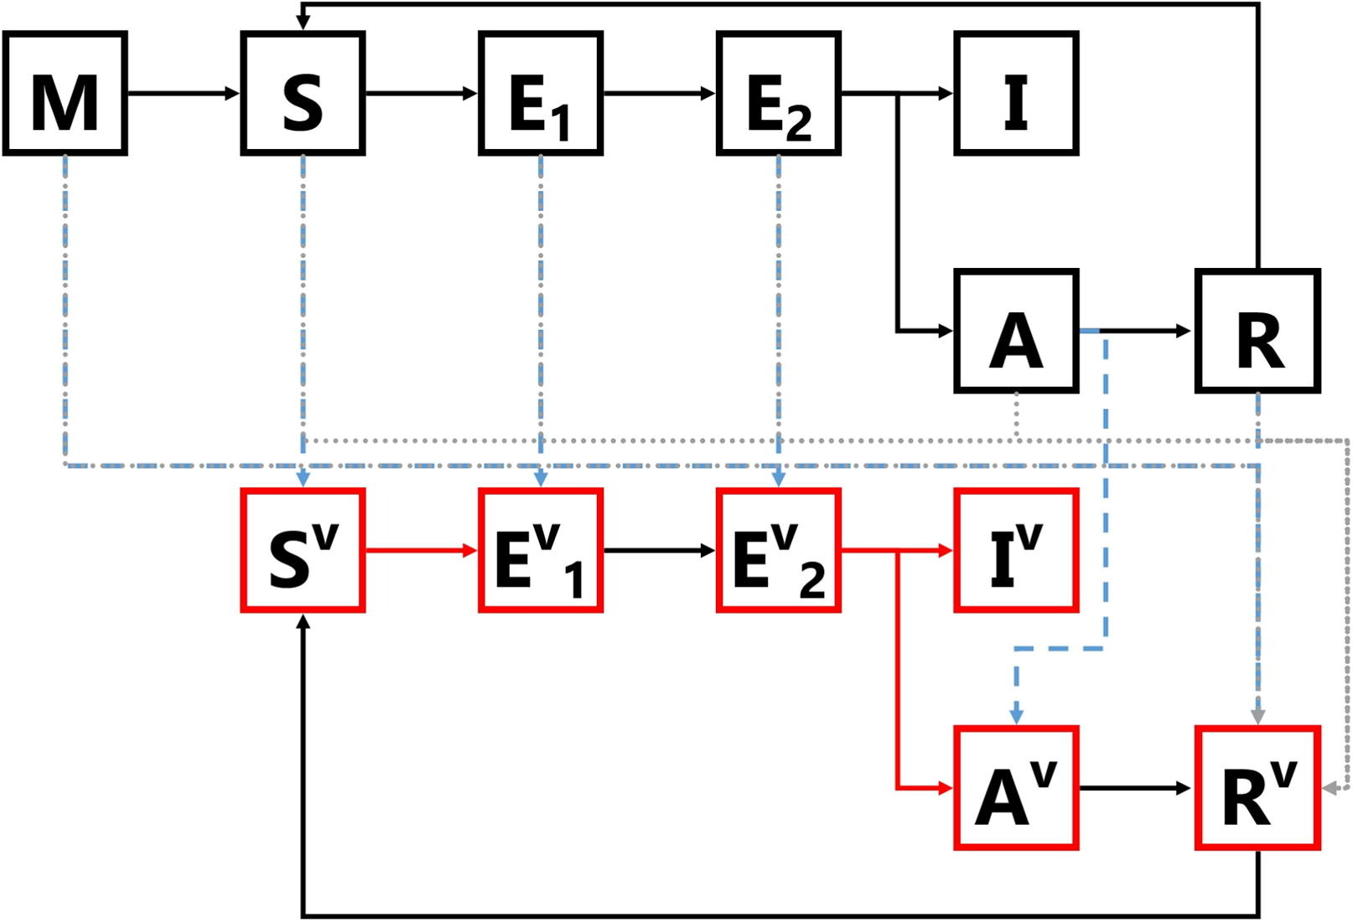
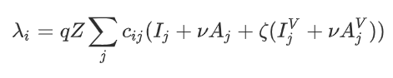
Model
Deterministic Susceptible, Exposed, Infectious, Recovered (SEIR) model
Individuals can be protected by Maternal antibodies
Infectious period is approximately gamma distributed
People can be asymptomatic
Age-structured
Transmission depends on effective social contacts between age groups (informed by POLYMOD)
Where q is the transmission rate, c is the contact rate, Z is a seasonal forcing term and ν is the scaling of infectiousness for asymptomatic people. (We will come back to vaccinated people).

Slide 21
Vaccination model
Essentially duplicated all disease progression for vaccinated individuals (except for maternal antibodies).
Vaccination can have multiple actions, either people join the corresponding compartment e.g.
S → S_{V}
or they move into the recovered
state (clearance)
Vaccinated infected individuals can contribute to the force of infection but at a reduced rate, ζ

Slide 22

Vaccine action and vaccination scenarios
6 age-targeted vaccination strategies
Age-stratified vaccine efficacy and effective coverage
A variety of vaccine actions that modulated:
Symptoms (progression to I or A)
Infectiousness (contribution to the force of infection)
Susceptibility (effect of the force of infection)
Clearance (whether people moved to R_{V} or not)

Slide 23
Sensitivity analysis
We examine a representative sample of the possible permutations using a Latin Hypercube Sample
Symptoms | Infectiousness | Susceptibility | Sample number
0% | 30% | 50% | 1
30% | 50% | 70% | 2
50% | 70% | 100% | 3
70% | 100% | 0% | 4
100% | 0% | 30% | 5
… | … | … | …

Slide 24

Results
Model fit

Slide 25

Results
Vaccine impact
Strategies that target infants are most efficient (i.e. more cases are prevented per dose) for less severe outcomes
For more severe outcomes, including hospitalisation and death, strategies that directly target older age groups, who are at highest risk of these severe outcomes, are more efficient

Slide 26
Conclusions
In terms of the overall burden of infection, the infant strategy could reduce the total number of infections by 4.53 % [3.10%, 5.29%] overall
The strategy targeting 70+ year olds (A4), which targets a much greater number of individuals, could reduce the total number of infections by 21.93% [6.79%, 26.05%]
The highest percentage reduction in infections, 70.5% [31.1%, 77.0%], comes as a result of strategy A2 which targets 1 and 50+ year olds
The most influential vaccine characteristics are clearance of infection and susceptibility

Slide 27
Summary
Dynamic effect of vaccination (changes in birth rates) equivalent to changes in transmission rates
Vaccination can have both direct and indirect impacts on transmission
Multiple different mechanisms can contribute to either of these effects
Can model flexibly by reflecting all life-history compartments for vaccinated individuals
Unlikely to know all vaccine effects before deployment
Sensitivity analysis

